Slide 1


Slide 2


Slide 3


Slide 4

https://www.google.com/images/srpr/logo11w.png,
http://pwl.if-uho.org/2023/images/mahasiswa/
yudhy.png

Slide 5
https://www.google.com/images/srpr/logo11w.png,
http://pwl.if-uho.org/2023/images/mahasiswa/
yudhy.png

Slide 6
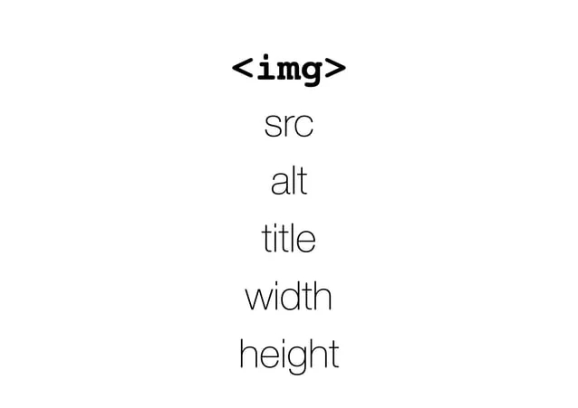

Slide 7
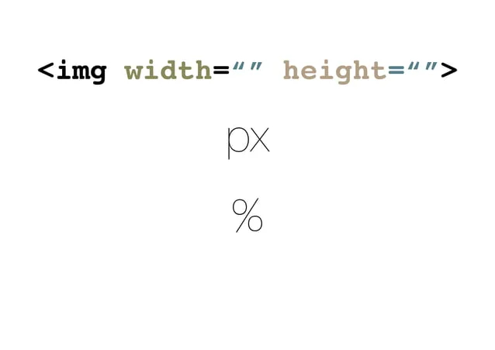

Slide 8


